Slide 1

RL – Tasks explanation
TA. Bogyeong Suh
Machine Learning &
Control Systems Lab.

Slide 2

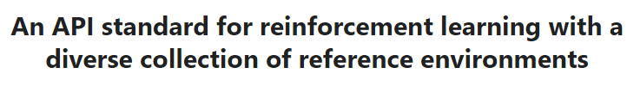
Task 1 & 2
Policy Iteration and Value Iteration with toy text environments
Gym interface is simple, pythonic, and capable of representing general RL problems.
It provides a variety of standardized environments to test and develop RL agents on, ranging from classic control problems to more sophisticated tasks such as playing Atari games.
Lunar Lander
Bipedal Walker
https://www.gymlibrary.dev/

Slide 3
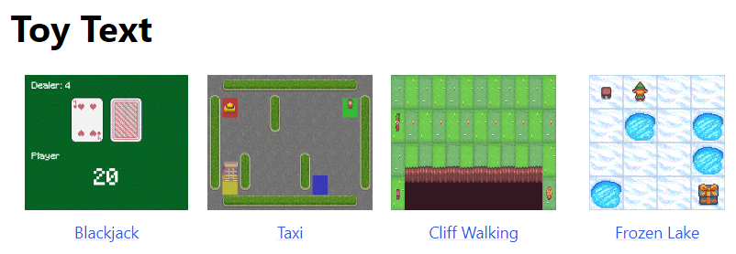
Task 1 & 2
Policy Iteration and Value Iteration with toy text environments
https://gymnasium.farama.org/environments/toy_text/
In these tasks, we will use one of toy text environments from gym library for practicing policy and value iteration methods.
The toy text environments have discrete state and action spaces, which are suitable for policy iteration and value iteration methods
Choose one of the toy text environments, and apply policy iteration method (Task 1) and value iteration method (Task 2), referring to the code files ‘policy_iteration.py’ and ‘value_iteration.py’.

Slide 4
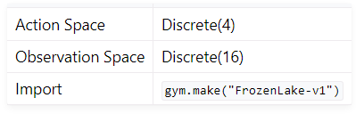
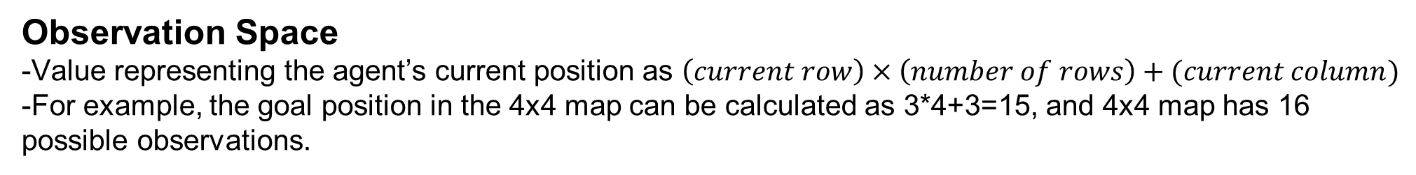
Task 1 & 2
e.g.) Frozen Lake
Frozen lake involves crossing a frozen lake from start to goal without falling into any holes by walking over the frozen lake. The player may not always move in the intended direction due to the slippery nature of the frozen lake
Start at [0,0], and goal position located at [3,3]
*Slippery option
-If True, the player will move in intended direction with probability of 1/3 else will move in other perpendicular direction with equal probability of 1/3 in both directions
Action Space
-0 (left), 1 (down), 2 (right), 3 (up)
Observation Space
-Value representing the agent’s current position as $\left(current row\right)×\left(number of rows\right)+(current column)$
-For example, the goal position in the 4x4 map can be calculated as 3*4+3=15, and 4x4 map has 16 possible observations.
Reward
- +1 (reach goal), 0 (reach hole), 0 (reach frozen)

Slide 5
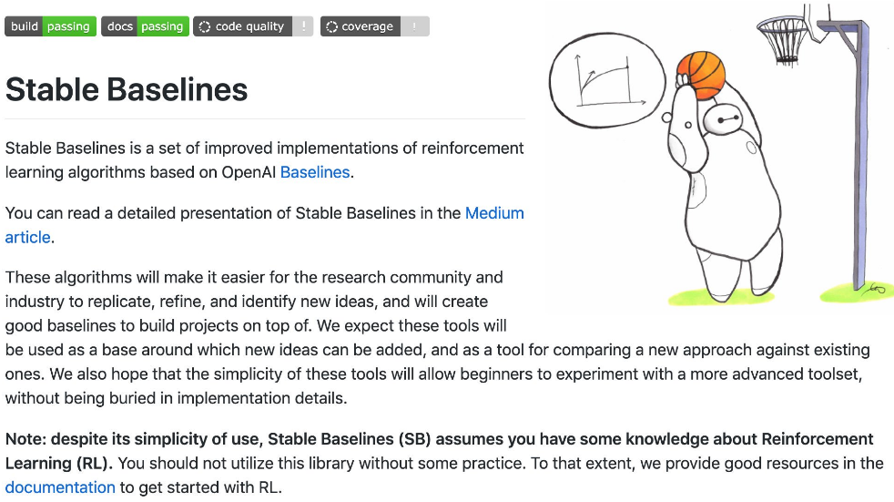
Task 3
Practice using models from Stable baselines
Use one of the RL algorithms available in stable baselines
https://stable-baselines.readthedocs.io/en/master/
Deep Deterministic Policy Gradient (DDPG)
Policy Gradient + Q-learning
Deep Q Network (DQN)
Q-learning + Deep neural networks
Soft Actor Critic (SAC)
Off-policy maximum entropy deep RL with a stochastic actor
Actor (policy) learns to optimize a trade-off between expected return and entropy (exploration).
Critic (Q-function) learns to evaluate the policy

Slide 6
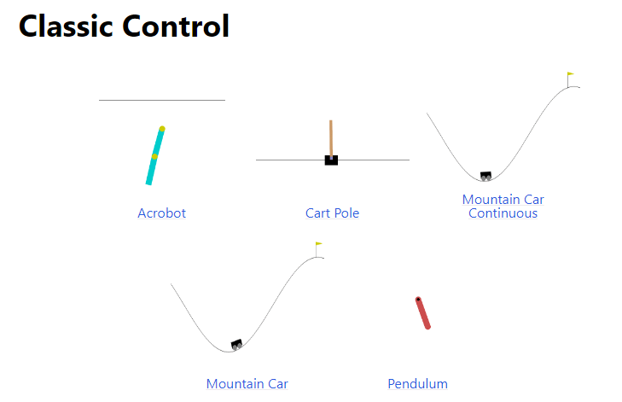
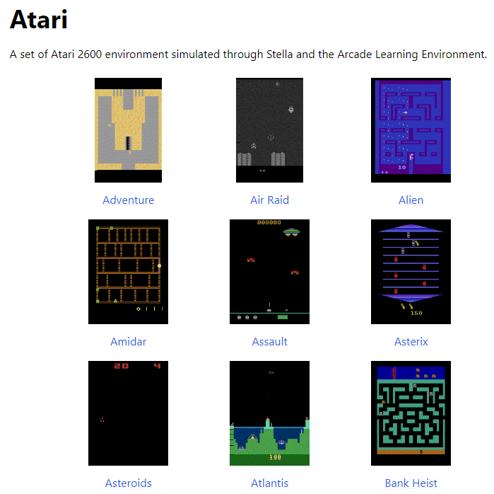
Task 3
Practice using models from Stable baselines
Example environments of gym
Choose one of the environments in gym (not chosen on task 1&2), and one RL algorithm in stable baselines(e.g. DQN, DDPG, SAC,…)

Slide 7
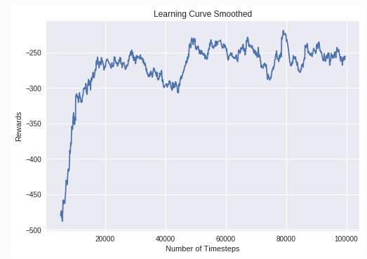
Task 3
Practice using models from Stable baselines
Save 1
Save 2
Save 3
Learning curve of DDPG on LunarLanderContinuous environment
Plot the above reward graph of your results on training the model
Use callback function to monitor training, and display points on the graph where the model is saved and reward is updated.
(The original callback function will save the first best reward at episode 100 as mean reward over the last 100 episodes, and then save the next best reward when the mean over the last 100 episodes is larger than the previously saved best reward.) When the reward is updated, the model is also saved.
https://stable-baselines.readthedocs.io/en/master/guide/examples.html

